Slide 1

Cloud-Based Services for Secure Healthcare: A Critical Evaluation and Implementation Study
SRM INSTITUTE OF SCIENCE AND TECHNOLOGY
FACULTY OF ENGINEERING AND TECHNOLOGY
DEPARTMENT OF NETWORKING AND COMMUNICATIONS
18CSP107L - MINOR PROJECT
Student 1 Reg No: RA2011028010099
Student 2 Reg No: RA2011028010071
Batch ID: Panel 12
Guide name and Designation: Dr.V.M.Gayathri (Associate Professor)

Slide 2
Table of Contents
Abstract
Introduction
Problem Statement
Objectives
Literature Review
UML Diagrams-ER diagrams/Use case diagram/Activity
Modules
Algorithm
Conclusion
References

Slide 3
ABSTRACT
The project emphasizes the importance of strong and updated security measures for all web transactions, especially in the healthcare sector.
The contribution of cloud-based services in the healthcare environment is a vital issue in the 21st century.
We provide and present its benefits and tools in hospitals, clinics, and diagnostic centers.
Security and risk assessment issues in cloud-based services are analyzed thoroughly together with some case studies.
Keywords: Data privacy, Data storage, Data transmission, Access control, Authentication, Data encryption.

Slide 4
INTRODUCTION
Nowadays, cloud computing has interfered in all sectors of human life. Marketing, education as well as healthcare are three of them which have been web digitalized. Cloud-based services have revolutionized the way information technology is utilized across various industries, including the healthcare sector. These services offer numerous benefits, such as scalability, flexibility, and cost-efficiency, making them increasingly popular in healthcare organizations. However, with the adoption of cloud-based services come security concerns that must be addressed to ensure the confidentiality, integrity, and availability of sensitive healthcare data This paper aims to provide a comprehensive categorization of cloud-based services in the healthcare sector and analyze their security aspects. By understanding the different types of cloud-based services and their associated security challenges, healthcare organizations can make informed decisions regarding the adoption of such services while safeguarding patient information and complying with regulatory requirements The categorization of cloud-based services in the healthcare sector is essential as it helps in understanding the diverse range of services available and their specific applications.
Furthermore, this paper will conduct a detailed security analysis of cloud-based services in the healthcare sector. It will explore the potential risks and vulnerabilities associated with the adoption of cloud services, such as unauthorized access, data breaches, and data loss. Additionally, it will discuss the security measures and best practices that healthcare organizations should implement to mitigate these risks effectively. These measures may include encryption, access controls, regular audits, and staff training.By evaluating the security aspects of cloud-based services, healthcare organizations can make informed decisions regarding the selection of service providers and the implementation of appropriate security measures. It is crucial to prioritize the protection of sensitive patient data to maintain patient trust, adhere to privacy regulations like the Health Insurance Portability and Accountability Act (HIPAA), and prevent potential legal and financial consequences.

Slide 5
PROBLEM STATEMENT
The healthcare sector has been increasingly adopting cloud-based services to enhance efficiency, collaboration, and accessibility of medical data. However, the utilization of cloud-based services in healthcare raises concerns regarding data security and privacy. To address these concerns, it is crucial to categorize cloud-based services in the healthcare sector and conduct a comprehensive security analysis to identify potential vulnerabilities and risks associated with each category.
By addressing the problem statement and achieving the objectives outlined above, this study aims to contribute to the improvement of cloud security practices in the healthcare sector, ultimately ensuring the protection of sensitive patient data and maintaining the trust of healthcare service providers and patients.

Slide 6
OBJECTIVES
The objective of the project "Cloud-Based Services for Secure Healthcare: A Critical Evaluation and Implementation Study" is to examine and classify the various types of cloud-based services used in the healthcare industry and conduct a comprehensive analysis of their security implications. The project aims to provide a systematic overview of cloud services and their associated security challenges in the context of healthcare, helping stakeholders make informed decisions about adopting and implementing cloud-based solutions. Specifically, the project may involve the following objectives:
Categorization of Cloud-Based Services: Identify and categorize different types of cloud-based services relevant to the healthcare sector. This categorization could include infrastructure as a service (IaaS), platform as a service (PaaS), software as a service (SaaS), storage as a service, and other related services.
Assessment of Security Risks: Analyze the security risks associated with each category of cloud-based service in the healthcare sector. This could involve evaluating potential vulnerabilities, threats, and data breaches that could arise from using these services. Consideration should be given to the sensitivity and privacy of healthcare data, regulatory compliance requirements (e.g., HIPAA), and best practices for securing patient information in the cloud.

Slide 7
OBJECTIVES
Evaluation of Security Measures: Assess the security measures and controls offered by cloud service providers for each category of service. This evaluation could include examining encryption protocols, access controls, authentication mechanisms, data backup and recovery procedures, and overall compliance with industry standards and regulations.
Comparative Analysis: Conduct a comparative analysis of different cloud service providers within each category, highlighting their strengths and weaknesses in terms of security. This analysis could involve evaluating their track record, reputation, certifications, and any specific security features they offer for healthcare organizations.

Slide 8
OBJECTIVES
Recommendations and Guidelines: Provide recommendations and guidelines for healthcare organizations on selecting, implementing, and managing cloud-based services while mitigating security risks. These recommendations should take into account the unique requirements and constraints of the healthcare sector and address key considerations such as data protection, regulatory compliance, and risk management.
By accomplishing these objectives, the project aims to contribute to the understanding of cloud-based services and their security implications in the healthcare sector, enabling healthcare organizations to make informed decisions about leveraging cloud technologies while ensuring the confidentiality, integrity, and availability of sensitive patient data.

Slide 9
LITERATURE REVIEW
[1] Revolutionary Impact of Cloud Solutions on Healthcare
It is challenging to bring changes to the healthcare sector due to numerous legacy systems as well as highly sensitive personal information. Throughout the globe, many governments experience innumerable problems in their initiatives for making healthcare services digitized. The healthcare structure as an entity suffers unprecedented challenges due to the ever-increasing expectations as well as rising demands.

Slide 10
[2] Real-time threat prediction for cloud based assets using big-data analytics
With reports on cloud related breaches becoming a daily occurrence, enterprises are looking for secure cloud infrastructure which can support their applications and data on cloud. Current cloud security solutions have been struggling to keep up with the rapid migration of organizational data and applications to the cloud. Traditional IT security services have long provided current information on vulnerabilities and attacks, but are no longer effective on the latest threat landscape. But legacy security solutions work in silos and can easily overlook the big picture. Old tools are no longer effective to thwart attacks. Hence there is a demand for greater security insight and preventive action across businesses using cloud infrastructure. A holistic approach to cloud security is needed to react quickly to the changes in an organization's threat landscape. This approach should include monitoring tools to deliver the latest security intelligence on cloud infrastructure and big-data analytics to predict and prevent upcoming threats. This research paper proposes a real-time security solution that provides predictive threat analysis to protect IT resources on the cloud. This model can be applied as a proposed shared security approach where organizations collaborate with each other to share the latest threat intelligence to predict threats, thereby enabling businesses to deliver new products and services faster, without interruption or security breaches.

Slide 11
[3] Risk Analysis of Cloud Sourcing in Healthcare and Public Health Industry
The task of protecting healthcare information systems (HIS) from immediate cyber security risks has been intertwined with cloud computing adoption. The data and resources of HISs are inherently shared with other systems for remote access, decision making, emergency, and other healthcare related perspectives. In the case of a multitude of requirements by multiple stakeholders, various, and diverse cloud models are being adopted across the healthcare and public health industry, which defies the real essence of sharing and using cloud computing in this domain. The misconception of security is one of the key hurdles in the adoption of cloud as a de facto standard in the healthcare and public health sector. In this paper, we demonstrate the similarity of the security aspects of the cloud computing models, by identifying the critical assets in the HIS, and by assessing their impact on the HIS. We also evaluate the risk exposure of the cloud computing models by performing a critical analysis. To the best of our knowledge, this is the first study of its kind for risk analysis of cloud computing models in order to demonstrate their suitability for the HIS.

Slide 12
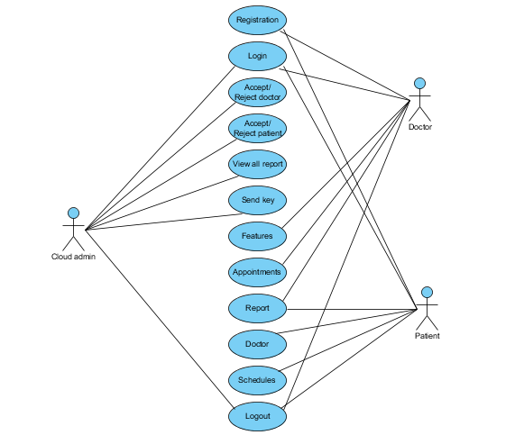
UML DIAGRAMS
Use Case Diagram:
A use-case diagram is a type of behavioral diagram defined by and created from a Use-case analysis. Its purpose is to present a graphical overview of the functionality provided by a system in terms of actors, their goals (represented as use cases), and any dependencies between those use cases. The main purpose of a use case diagram is to show what system functions are performed for which actor. Roles of the actors in the system can be depicted.

Slide 13
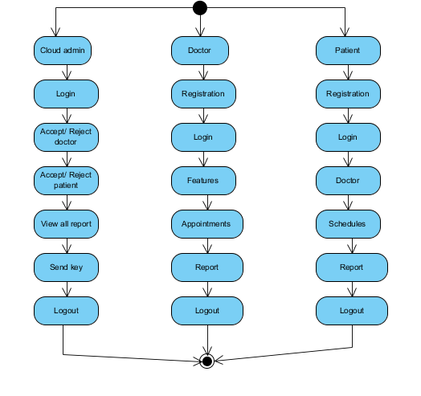
UML DIAGRAMS
Activity Diagram:
Activity diagrams are graphical representations of workflows of stepwise activities and actions with support for choice, iteration and concurrency. In the Unified Modeling Language, activity diagrams can be used to describe the business and operational step-by-step workflows of components in a system. An activity diagram shows the overall flow of control.

Slide 14
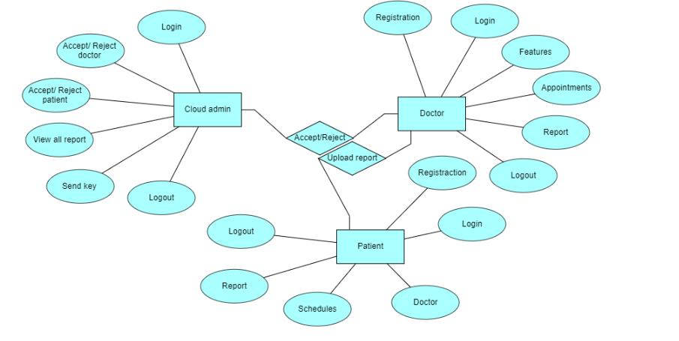
UML DIAGRAMS
ER Diagram:
An Entity–relationship model (ER model) describes the structure of a database with the help of a diagram, which is known as an Entity Relationship Diagram (ER Diagram). An ER model is a design or blueprint of a database that can later be implemented as a database. An ER diagram shows the relationship among entity sets. An entity set is a group of similar entities and these entities can have attributes. ER diagram shows the complete logical structure of a database.

Slide 15
MODULES
Cloud admin: The cloud admin will login with the default email and password.
Accept / Reject Doctor: Once the doctor will register they can’t login directly here the admin has to accept /reject them.
Accept / Reject Patient: Once the patient will register they can’t login directly here the admin has to accept /reject them.
View all report: The admin will view all the report which is uploaded by the doctor.
Send key: The admin will view the report and accept the request and send key through email to patient.
Logout: Finally Logout from the website

Slide 16
MODULES
Doctor: The doctor checks the health of the patients and sends reports to the patients.
Registration: The doctor will register with his/her details like name, email, password, contact, address and Role.
Login: After registration the Doctor will login with email and password.
Add Features: Here the doctor will add the features which will be provided by then and the description of that feature.
Appointments: Here the doctor will view the appointment which is scheduled by the patient, after that he is going to add the report for the patient based on the patient decease.
Report: After uploading the report the doctor can view the report which is uploaded by his.
Logout: Finally Logout from the website

Slide 17
MODULES
Patient: Patients can book a slot for checkup and view their health reports.
Registration: The patient will register with his/her details like name, email, password, contact, address.
Login: After registration the patient will login with email and password.
Doctors: The patient will the doctor details and the features which is added by the doctors.
Schedules: Here the patient he/she will schedule the slot for appointment.
Reports: The Patient can view the report which is uploaded by the doctor and he can download that document by entering the secret key which is sent by the doctor through email.
Logout: Finally Logout from the website

Slide 18
ALGORITHM USED
AES(Advanced Encryption Standard)
Key features of AES include:
Symmetric Encryption: AES is a symmetric encryption algorithm, which means the same key is used for both encryption and decryption. This key must be kept secret, as anyone who possesses it can decrypt the encrypted data.
Block Cipher: AES operates on fixed-size blocks of data, typically 128 bits (16 bytes) at a time. Longer messages are divided into blocks, and each block is encrypted separately.
Key Lengths: AES supports key lengths of 128, 192, and 256 bits. Longer key lengths generally provide stronger security but can also require more computational resources.
Substitution-Permutation Network: AES uses a combination of substitution and permutation operations in multiple rounds to scramble and transform the input data.
Rounds: The number of encryption rounds in AES varies based on the key length: 10 rounds for a 128-bit key, 12 rounds for a 192-bit key, and 14 rounds for a 256-bit key.Key Expansion: AES employs a key expansion algorithm to generate a set of round keys from the initial encryption key. These round keys are used in each round to perform the encryption operations.
Confusion and Diffusion: AES employs the cryptographic concepts of confusion and diffusion, which make it difficult to discern any patterns in the relationship between the plaintext, the ciphertext, and the encryption key.
Security: AES is considered highly secure and has withstood extensive cryptanalysis. Its strength lies in the difficulty of breaking the encryption through brute force attacks, where an attacker tries all possible keys until the correct one is found.AES encryption is used in various applications, including securing sensitive data in storage and communication, as well as in protocols like SSL/TLS for securing online transactions and communications. It's also a fundamental component of modern cryptography and has been adopted by governments, organizations, and individuals around the world to ensure the confidentiality and integrity of their data.

Slide 19
CONCLUSION
In conclusion, this project highlights the importance of addressing security and risk assessment issues in cloud-based services for the healthcare sector. The proposed scheme offers an eye-catching categorization of cloud benefits and threats, streamlining information exchange and management. This project aims to foster secure cloud adoption in healthcare, contributing to improved patient care and data protection.
In this way, the information exchange and management are boosted because less time is consumed. This is a necessary precondition for the implementation of future trends.

Slide 20
REFERENCES
Sinhasane, S. (2019). Revolutionary Impact of Cloud Solutions on Healthcare. [Online] Gartner, Inc., https://gtnr.it/2PAcf79, Accessed on 27th February 2020
Spok (2019) “Infographic: How Healthcare Deploys Software as a Service (SaaS)”, https://bit.ly/38uLcR4, Accessed on 6th March 2020
Thriveni T. K. and Dr Prashanth C S R (2015) “Real-time threat prediction for cloud based assets using big-data analytics”, https://bit.ly/2YgTbQ6, Accessed on 20th June 2020
Abrar H., Hussain S. J., Chaudhry J., Saleem K., Orgun M. A., Muhtadi J. A. and Valli C. (2018) “Risk Analysis of Cloud Sourcing in Healthcare and Public Health Industry”, https://bit.ly/38fEEWr, Accessed on 24th February 2020

Slide 21
Thank You

